Slide 1
Nested Vectored Interrupt Controller (NVIC)

Slide 2
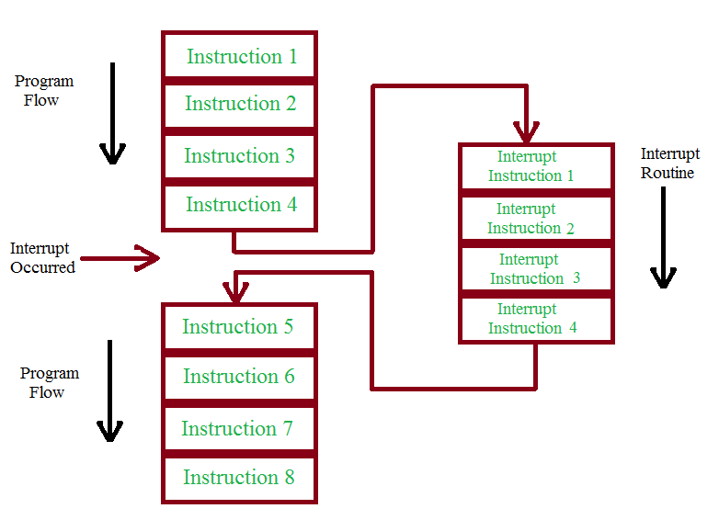
Interrupt Introduction
Interrupts can be defined as a system exception or peripheral interrupts which can cause the program flow to jump to a different position. As the name implies, interrupts get in the way of normal program execution.
An interrupt can be generated from both hardware (i.e. external inputs, reset button, or other peripheral) and software (i.e. internal inputs or kernel interrupts). Almost every microcontroller, nowadays, supports interrupt capability.
An interrupt is a signal sent to the processor by hardware or software indicating an event that needs immediate attention.

Slide 3
NVIC
The Nested Vector Interrupt Controller provides a fast response to interrupt requests, allowing an application to quickly serve incoming events.
NVIC is an on-chip controller that provides fast and low latency response to interrupt-driven events in ARM Cortex-M MCUs
We can also configure the interrupt controller according to our needs using specific registers.
The mode of operation of most of the interrupt registers is privileged i.e. they can only be accessed in privileged mode, but if the interrupt is a software interrupt than these registers can be accessed in user mode also.
There are a total of 256 interrupts that Cortex-M supports. Interrupt numbered from 0-15 i.e. the first 16 interrupts are dedicated to system interrupts and all the other interrupts i.e. 16-255 are referred to as a user or peripheral interrupts.

Slide 4
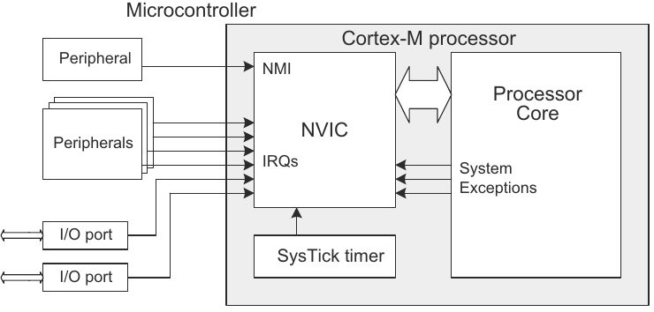
(Non-Maskable Interrupt)
(Interrupt Request)

Slide 5
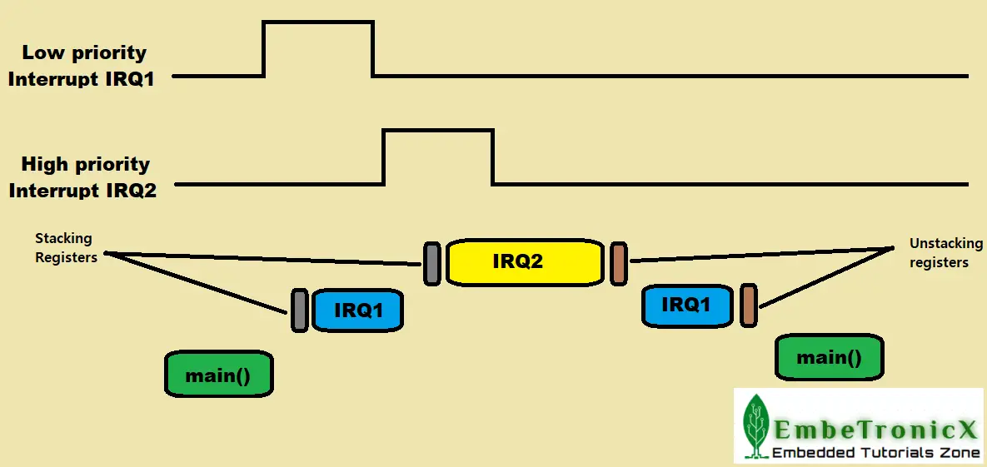
What is nested Interrupt?
In C language, we used nested if() case, which is if() inside the another if() case.
The same thing here also. Assume that the lower priority interrupt’s ISR is executing. Suddenly, a higher priority interrupt got triggered. That time, lower priority interrupt has been paused and higher priority interrupt will be executed.
Once, the higher priority interrupt finishes, then the lower priority interrupts will resume. This is called a nested interrupt. The higher priority interrupt Preempts the lower priority interrupt (Preemption).

Slide 6
main responsibilities of NVIC:
1. Managing Interrupts
Enable or disable individual interrupts.
Keep track of the current state of each interrupt (enabled, pending, active).
4. Vector Table Support
Provides direct mapping of each interrupt to its corresponding vector address (ISR).
Reduces latency compared to polling or centralized interrupt systems.
2. Prioritizing Interrupts
Assign and handle priority levels for each interrupt.
Supports preemption: higher-priority interrupts can interrupt lower-priority ones.
5. Handling Software-Triggered Interrupts
Supports software-triggered interrupts via the STIR register, allowing software to simulate an interrupt.
3. Supporting Nested Interrupts
Allows interrupt nesting, where higher-priority interrupts can interrupt lower-priority interrupt service routines (ISRs).

Slide 7
main responsibilities of NVIC:
6. Managing Interrupt States
Maintains pending, active, and enabled status bits for each interrupt:
  Pending: interrupt is requested but not yet serviced.
  Active: interrupt is currently being serviced.
  Enabled: interrupt is allowed to be serviced.
8. Tail Chaining
Automatically reduces latency between servicing back-to-back interrupts by skipping unnecessary context restore/save.
9. Late Arrival Handling
Automatically preempts ISR entry for a lower-priority interrupt if a higher-priority interrupt arrives before ISR execution starts.
7. Integrating with Power Management
Coordinates with low-power modes (e.g., WFI – Wait for Interrupt/WFE – Wait for Event) to wake the CPU when an interrupt occurs.

Slide 8
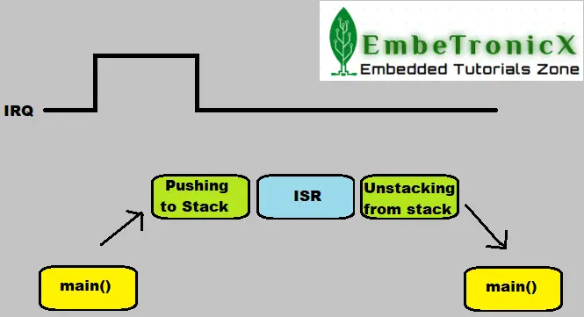
What happens when an interrupt triggered in Cortex-M3 or M4?
Step 1: Interrupt Request & Pending Check
The NVIC checks if:
An interrupt is pending (via NVIC_ISPR).
The interrupt is enabled (via NVIC_ISER).
Its priority is higher than the currently executing context.
Step 2: Current Instruction Completes
The processor finishes executing the current instruction before servicing the interrupt.
Step 3: Stack Operation (Context Save)
The processor automatically pushes the following 8 registers onto the current stack (Main Stack or Process Stack):
R0, R1, R2, R3, R12, LR, PC, xPSR
This is called automatic stacking, and it preserves the current context so execution can be resumed later.
Step 4: Set Exception Return Code (LR)
The Link Register (LR) is loaded with a special EXC_RETURN value, which tells the processor how to return from the ISR.
Value Meaning
          0xFFFFFFF1 Return to Handler mode, using MSP
          0xFFFFFFF9 Return to Thread mode, using MSP
          0xFFFFFFFD Return to Thread mode, using PSP
          0xFFFFFFE1, 0xFFFFFFE9, 0xFFFFFFED Used when FPU is active (Cortex-M4 with FPU)

Slide 9
What happens when an interrupt triggered in Cortex-M3 or M4?
Step 5: Set IPSR
The Interrupt Program Status Register (IPSR) is updated with the exception number of the interrupt being serviced.
Step 6: Fetch ISR Address
The processor reads the address of the ISR from the vector table using the interrupt number.
Step 7: Jump to ISR
The Program Counter (PC) is loaded with the ISR address.
Execution jumps to the Interrupt Service Routine (ISR).

Slide 10
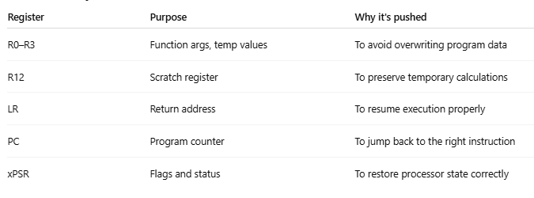
Just for your understanding
Why these 8 registers are pushed?

Slide 11
Tail chaining
Interrupts that occur back-to-back
This is one of the great features to reduce interrupt latency when multiple interrupts are in a pending state.
Assume this scenario. IRQ1 got triggered. Then processor will stack the registers to the stack and switch to the ISR. During the execution of the ISR, another IRQ2 got triggered which is the same priority as IRQ1 or less priority than IRQ1. So, nested or Preemption will not happen as IRQ2 is the same or less priority. It will wait until the processor finishes the IRQ1. Once it finishes the IRQ1, then the processor will unstack the registers from the stack and resume the normal operation. But since the IRQ2 is in a pending state, it will again be stacking the registers and processing the IRQ2.
If you look at the above execution, after the processor finishes the IRQ1, the unstacking and stacking takes place. The tail chain will remove the unnecessary unstacking and stacking. That will save some time and reduce the interrupt latency.
Tail chaining is when the processor, upon finishing an interrupt, immediately starts servicing another pending, higher-priority interrupt without fully restoring the previous context.

Slide 12
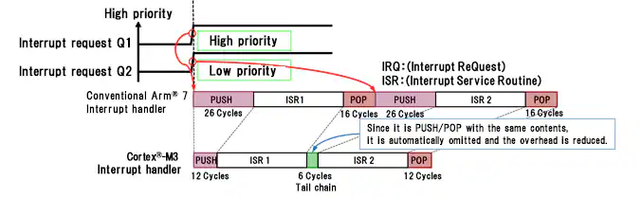
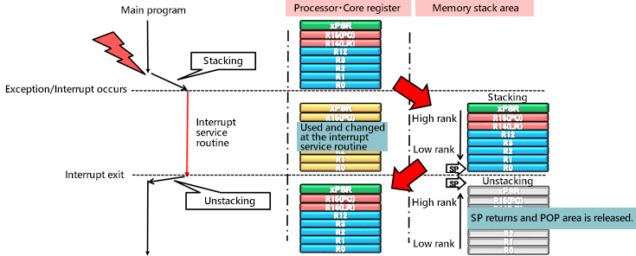
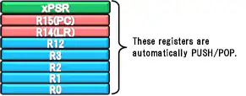

Slide 13
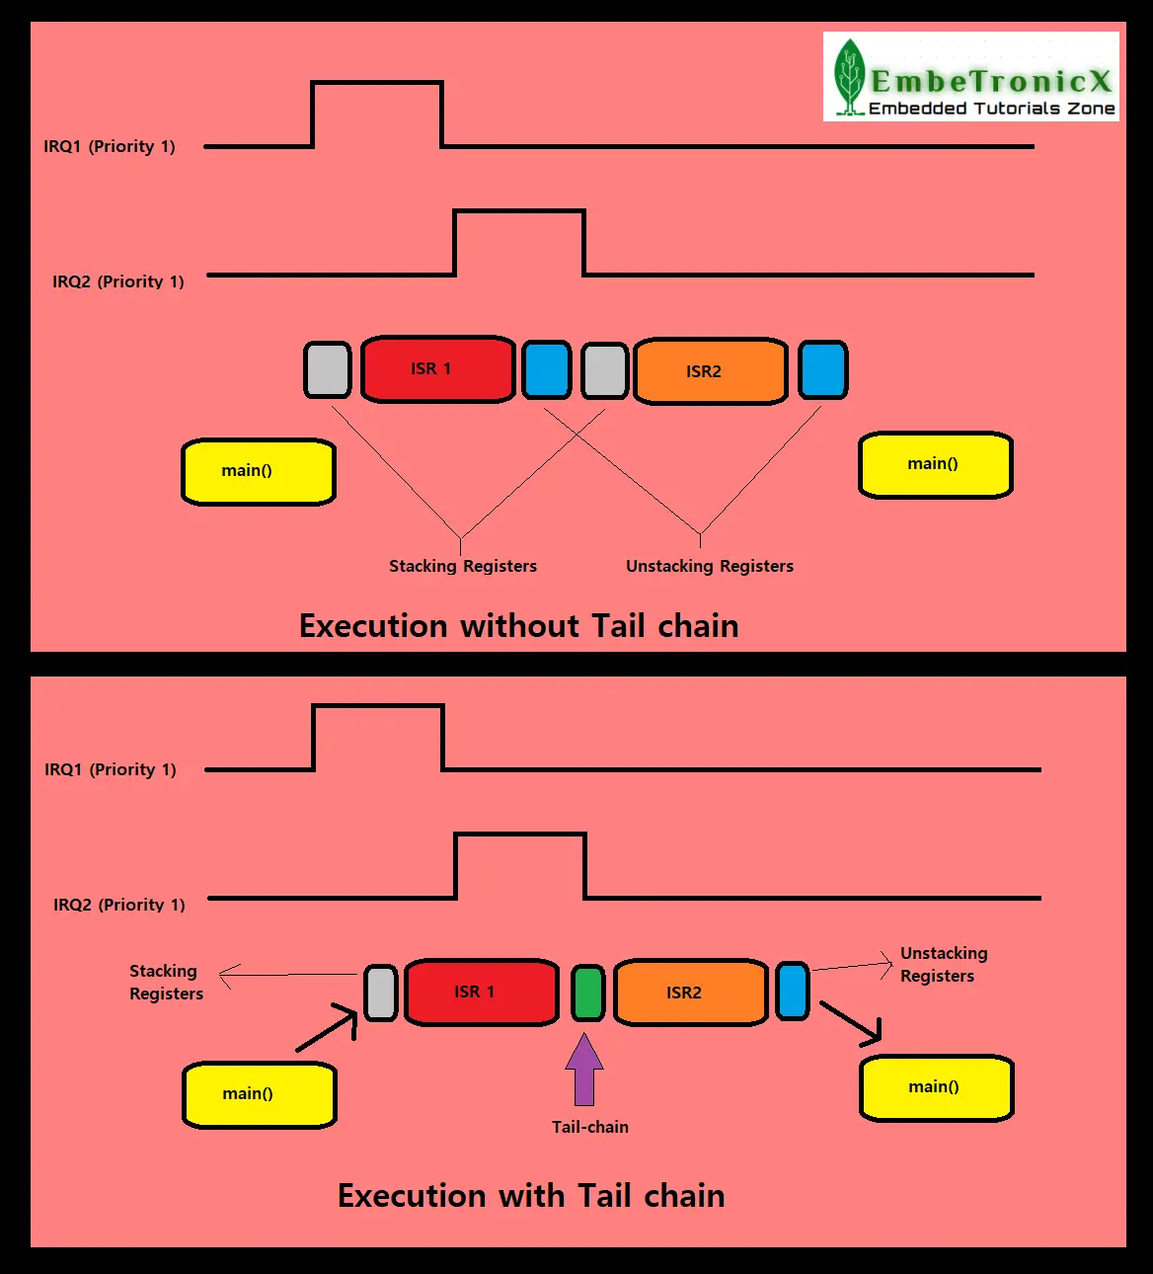

Slide 14
Late arrival
Tail-chaining technology in the NVIC supports interrupts that occur back-to-back, but there could be cases where higher priority interrupts could also occur during the stacking (Push) or unstacking (Pop) stages of the interrupt being serviced.
In case of the late arrival of a higher priority interrupt during the execution of the stacking registers for a previous interrupt, the NVIC immediately fetches a new vector address to service the higher priority pending interrupt.
In case of the late arrival of a higher priority interrupt during the execution of the unstacking (restore or pop) registers, NVIC abandons an unstacking (restore or pop) and services the new interrupt immediately.

Slide 15


